Slide 1
RICEBOX

Slide 2
TABLE OF CONTENTS
About the Project
01
04
Demo
Competitors vs Us
02
05
Technologies
Project Goals
03
06
Our Team
What it is, and a quick overview of the key components
A demonstration of the project and it’s capabilities
What the market has to offer and how our solution differs
What we used to create the project
How we plan to make the project better in the future
Who we are and who did what

Slide 3
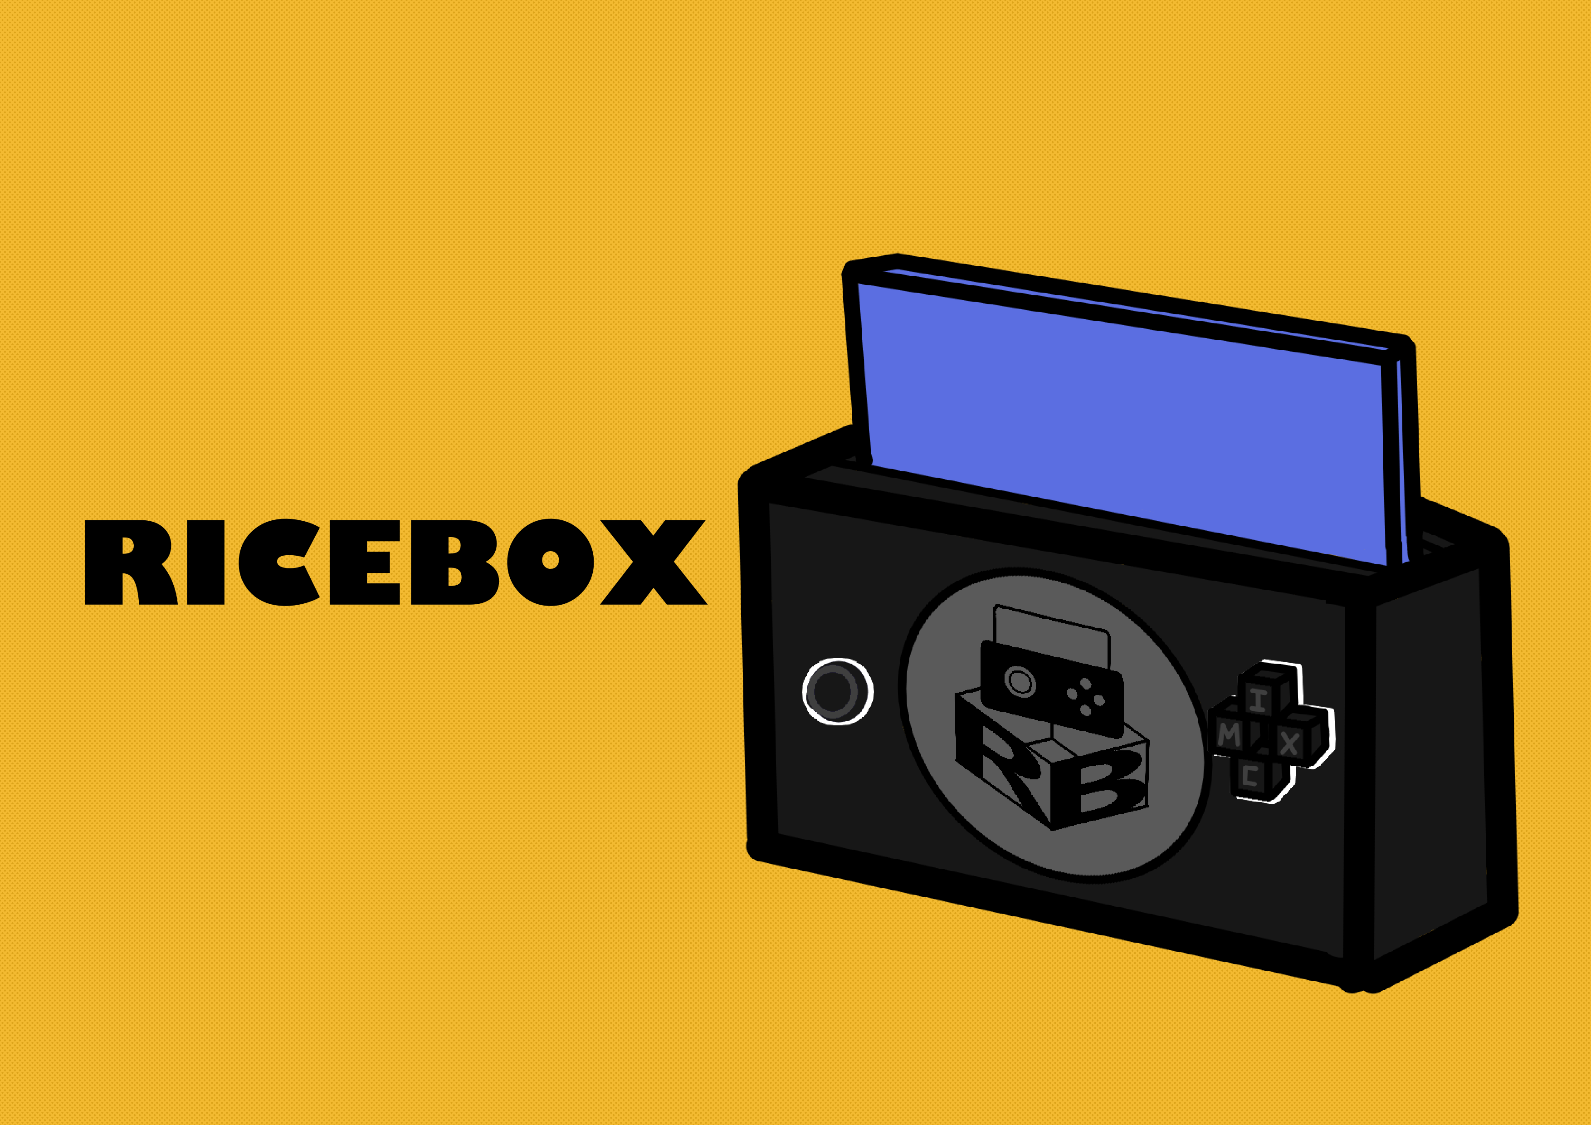
ABOUT THE PROJECT
- A gaming console - Seperated docked processing unit and handheld controller
- Sliding screen that locks in place using magnets
- 4 action buttons

Slide 4

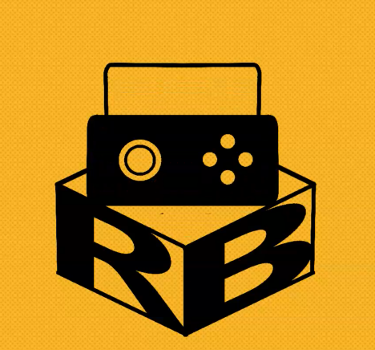
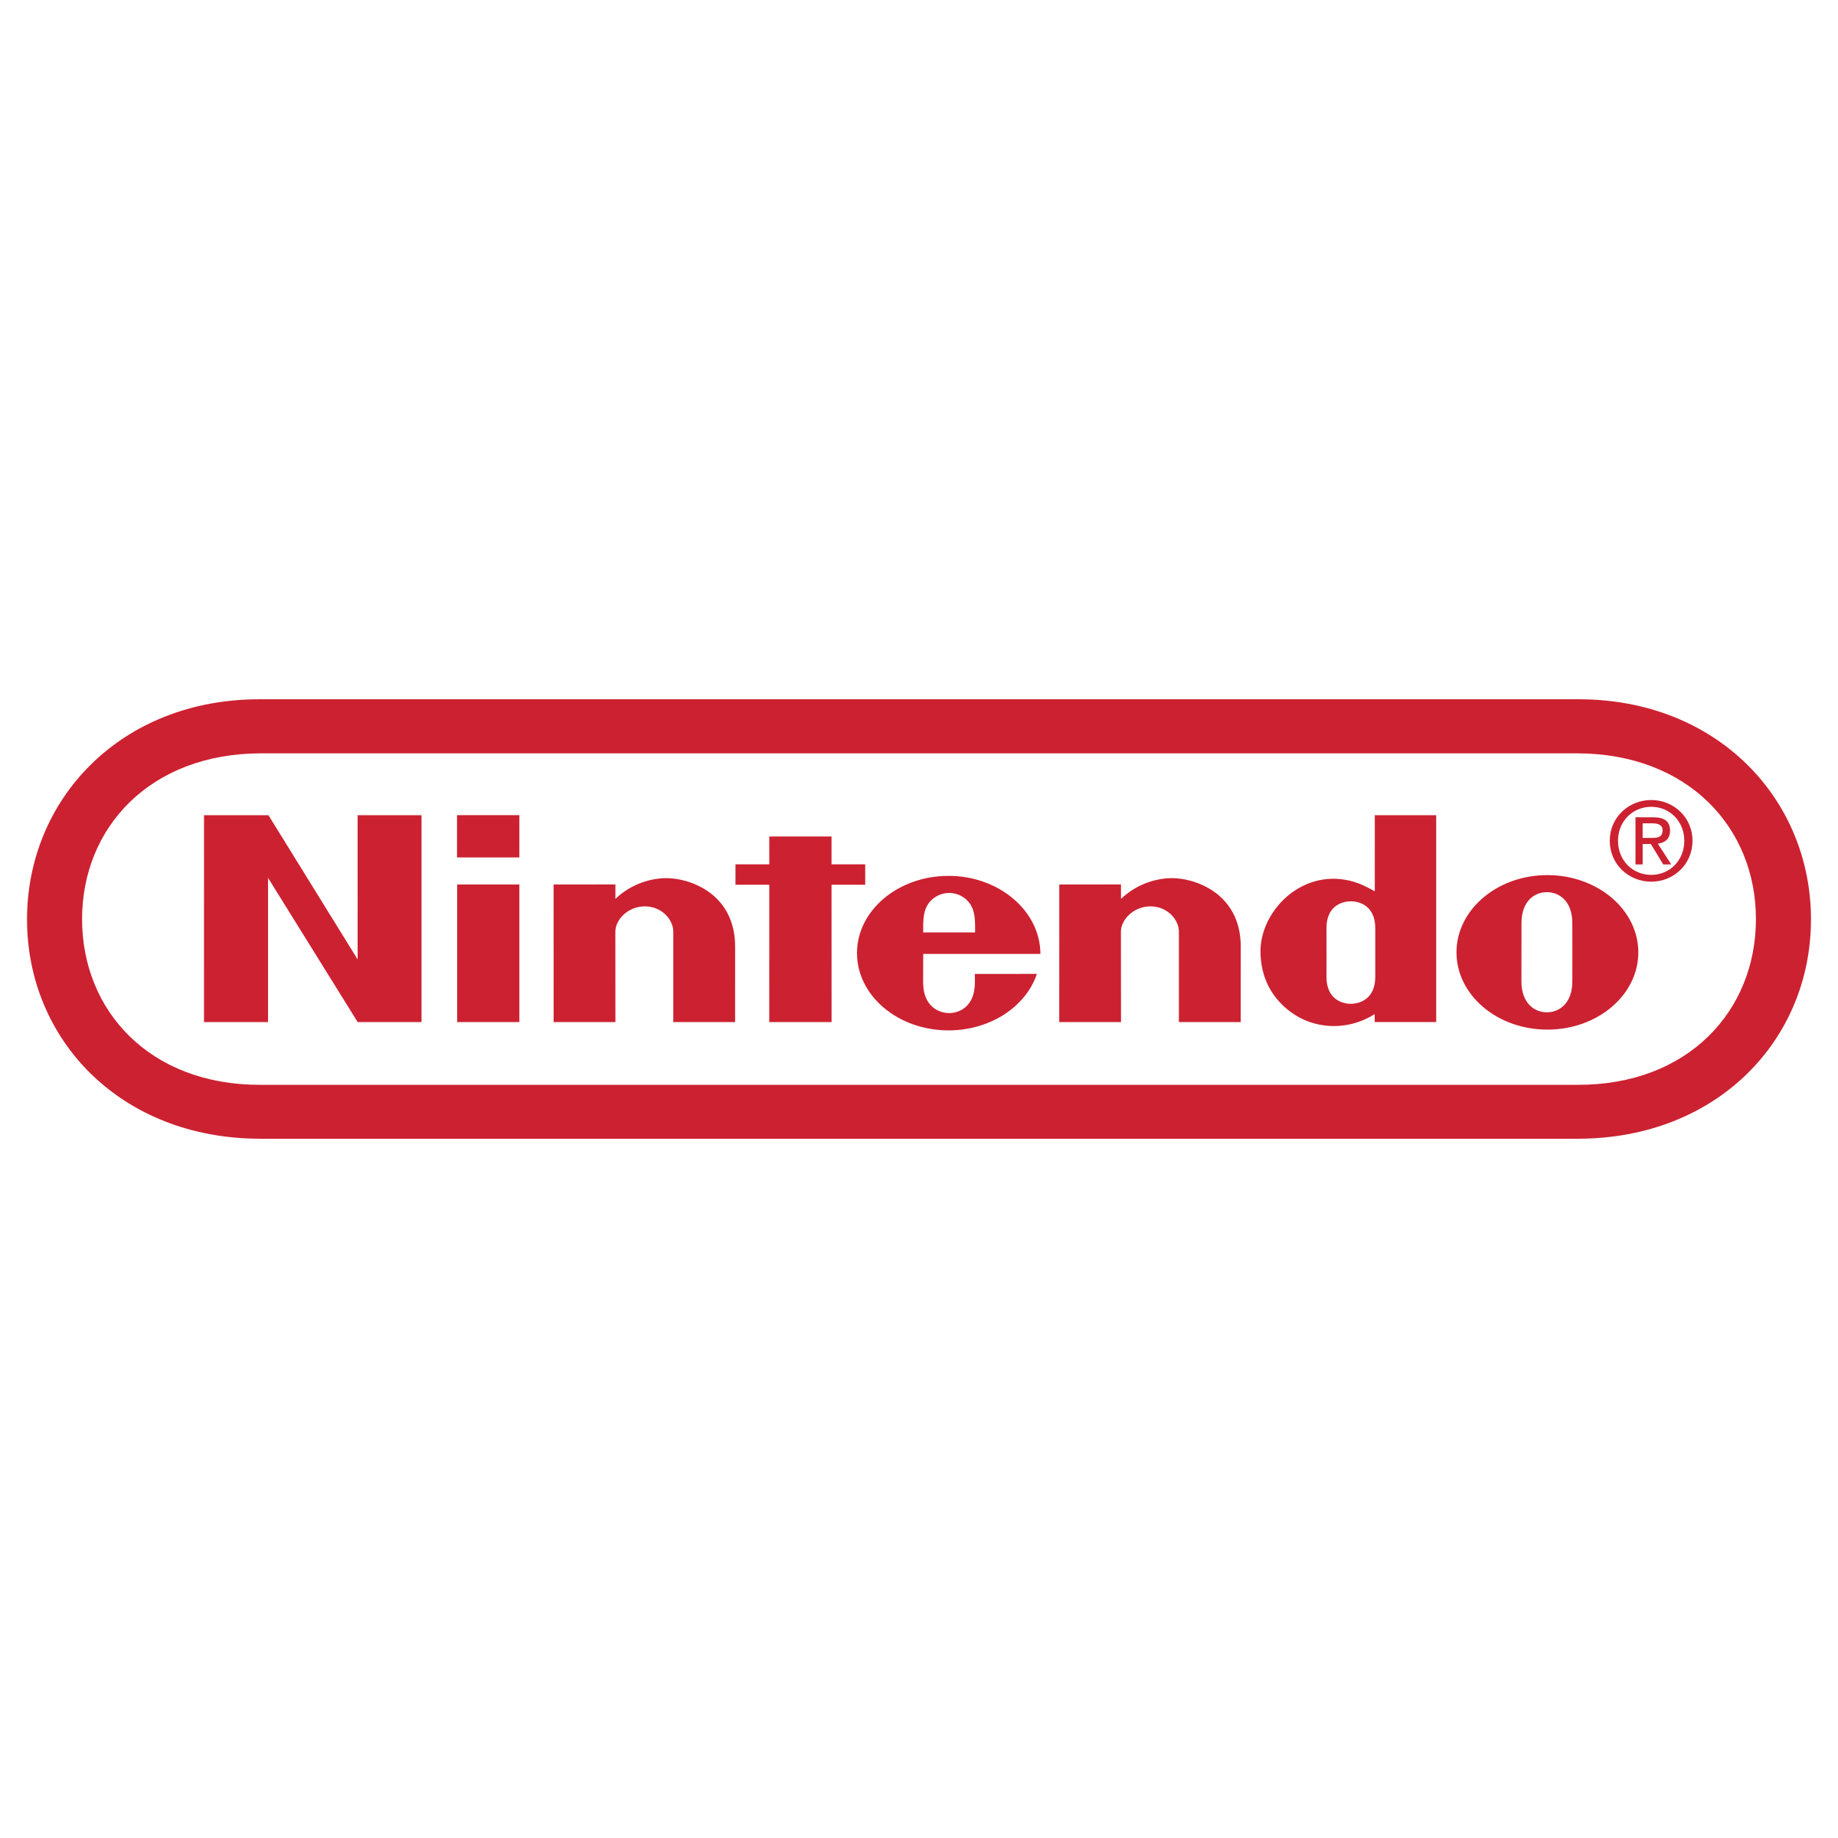

COMPETITORS
VS
US

Slide 5
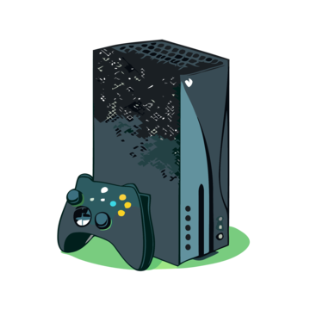
XBOX
Powerful Hardware
Cheaper price
Gamepass
PROS
CONS
No exclusive games
Loud controllers
Hard to expand storage

Slide 6
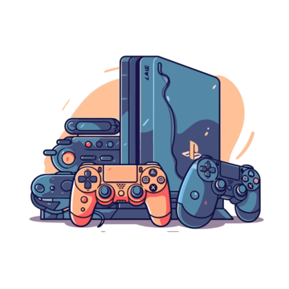
PLAYSTATION
Powerful Hardware
Lots of exclusive games
Great performance
PROS
CONS
Higher price
Poor compatibility
PS plus

Slide 7
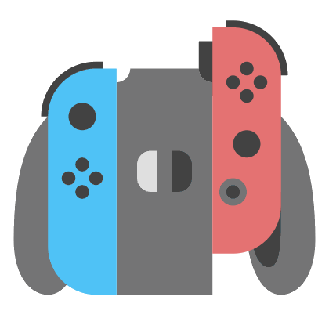
NINTENDO
Portable
Lots of exclusive games
Control schemes
PROS
CONS
Expensive
Shoddy hardware
Poor performance

Slide 8
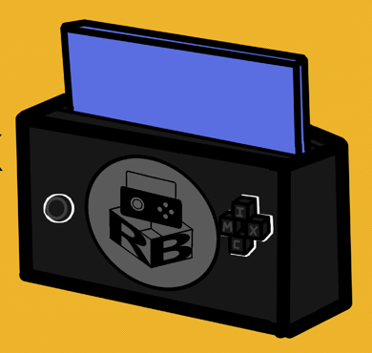
RICEBOX
Scalable Hardware
Easy game porting
Highly compatible

Slide 9
DEMO

Slide 10
FUTURE PLANS
Playstore
Design Improvement
BETA
RELEASE
FUTURE
VERSIONS
Better hardware
Game Formater & Games on USB

Slide 11

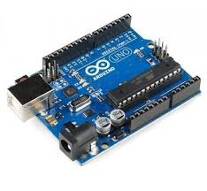

TECHNOLOGIES
Raspberry PI
Arduino UNO R4 Wi-Fi
Godot Engine

Slide 12





Dimitar
Kristian
Pavel
Toni
Alexander
The functionality wizard
The connection master
The designer
The logic mastermind
The tech expert
- Controller software - Testing - Five nights at Candy’s
- Controller hardware - Motherboard design - Hope
- Wi-Fi connection
- Main Menu -Majka Zajka
- Game assets - organization and communication - 3D models
- Game porting - Auto updater
- OS setup -Jump And Warp

Slide 13
THANKS!
We are ready for your questions!

